Slide 1

Incident Analysis Rapid investigation

Slide 2
Search head Indexer Forwarder’s
Notes:
Splunk is a general-purpose search, analysis and reporting engine for time-series text data, typically machine data.
MapReduce: Google’s data processing system is called Sawzall and Yahoo’s is called Pig.

Slide 3
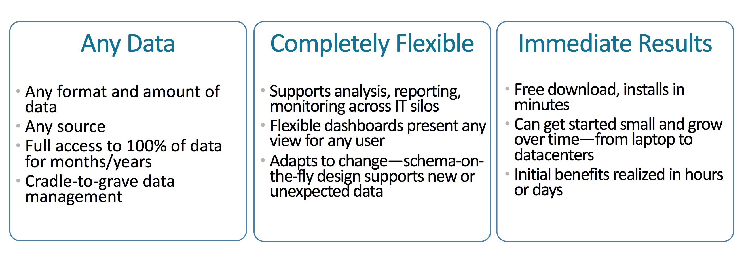

Slide 4
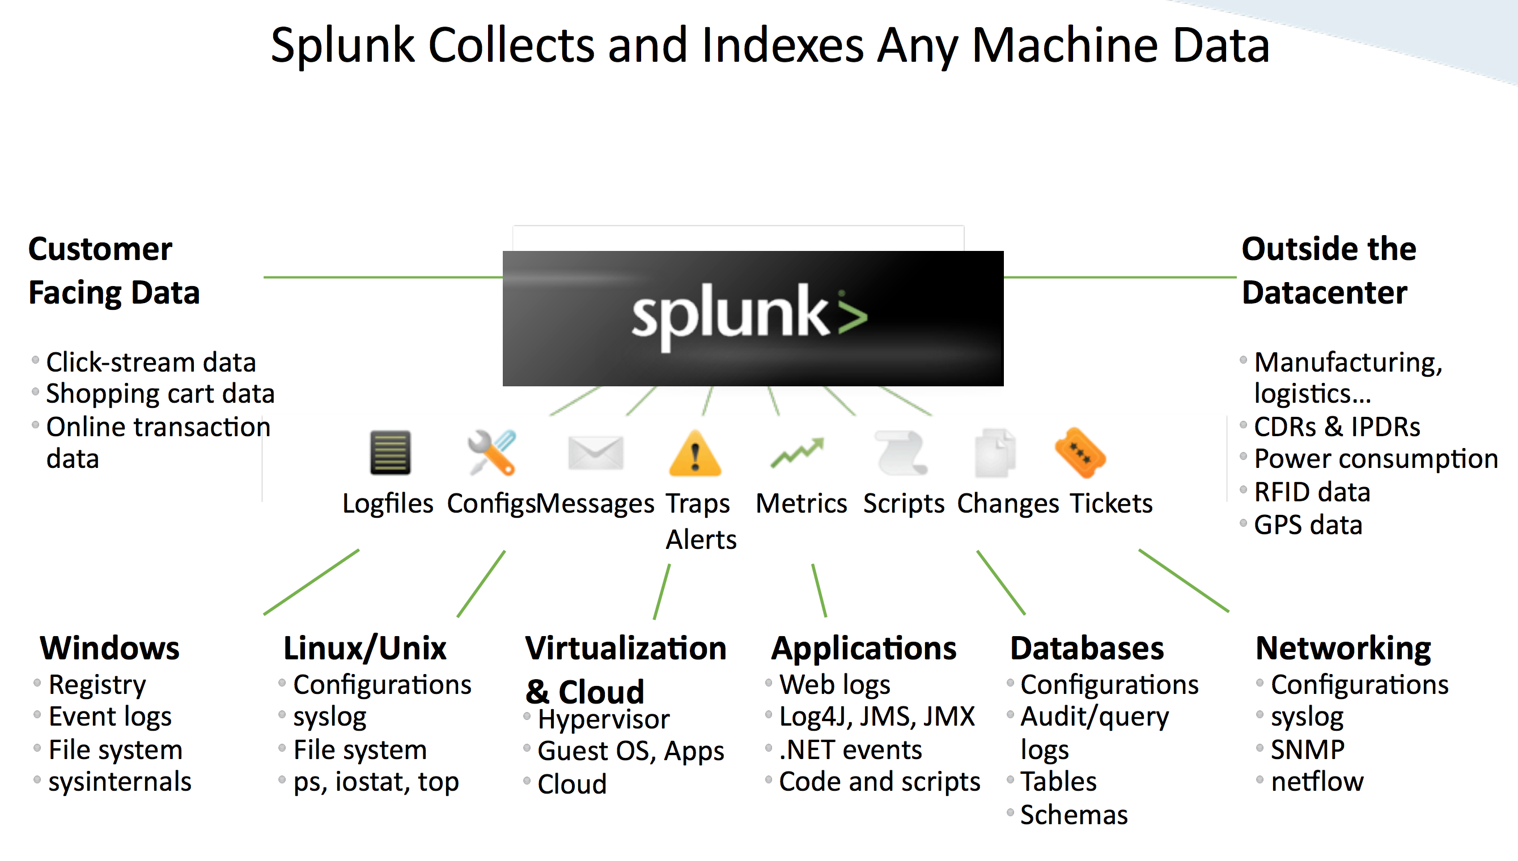
Notes:
Splunk software makes SOC personnel and processes more effective

Slide 5
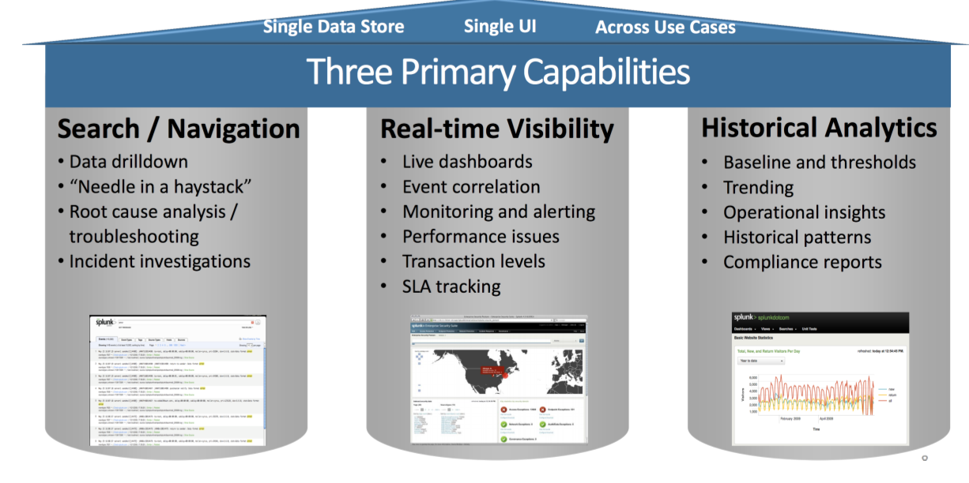

-Its in Leader from 4Years -get 219,572 in 12.32sec
Notes:
• Splunk software can be used to build and operate security operations centers (SOC) of any size (large, med, small)

Slide 6
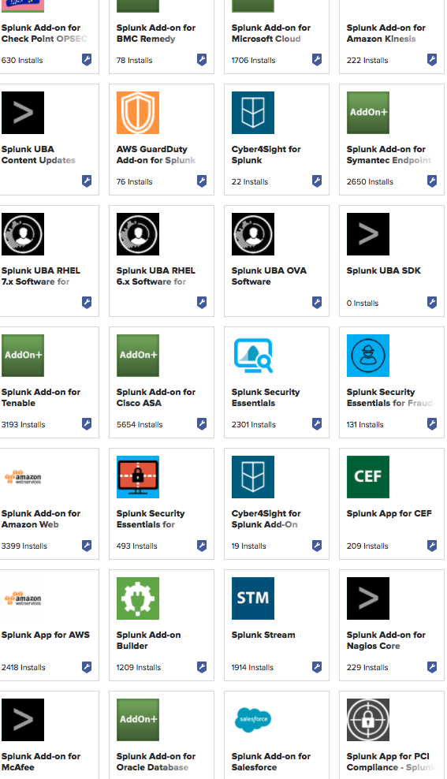
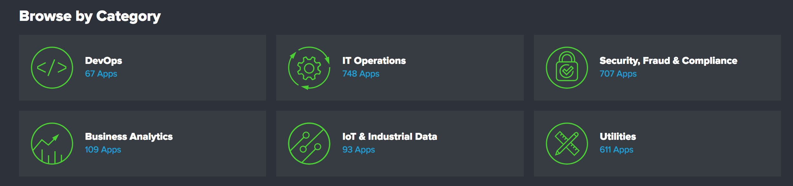
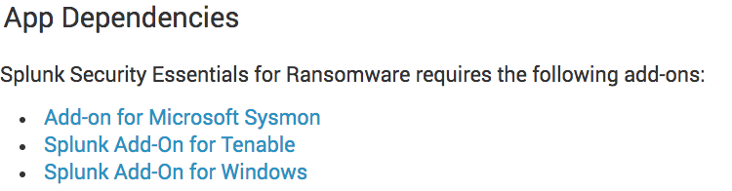
App: Heavy (configurations and Dashboards)
Add-Ons: Light weight (Only configurations)
Notes:
Out-of-the-box support for SIEM and security use cases
• Detect known and unknown threats, investigate threats, determine compliance and use advanced security analytics for detailed insight
Proven integrated, big data-based security intelligence platform

Slide 7
Splunk Enterprise Security Posture - Malware Analysis

Slide 8
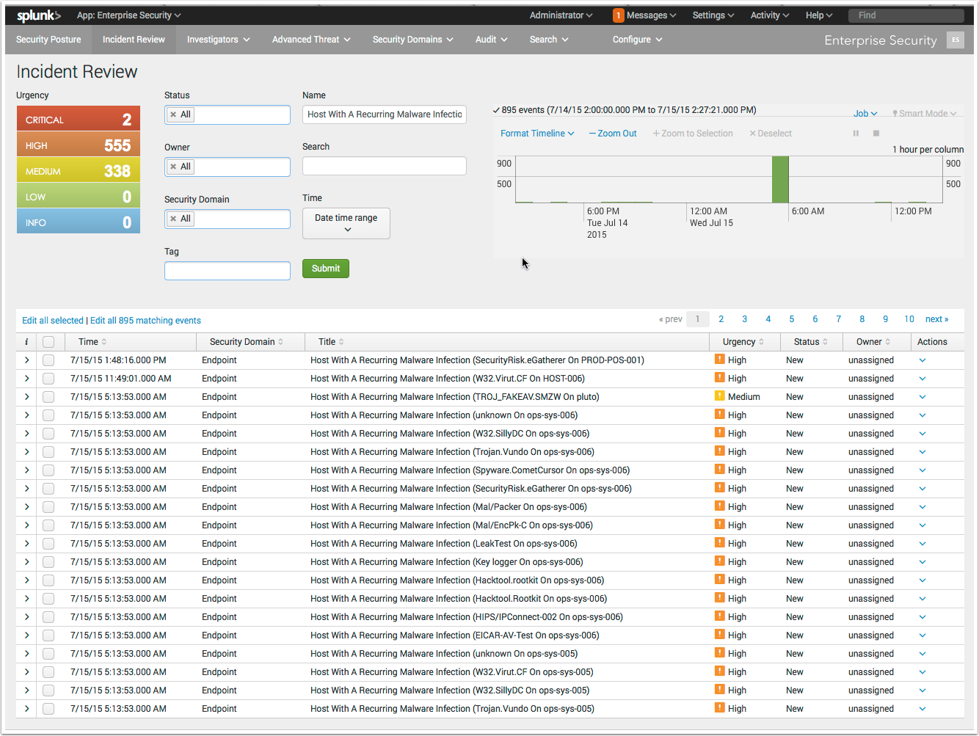
ES:Iincident Review - Malware Analysis

Slide 9
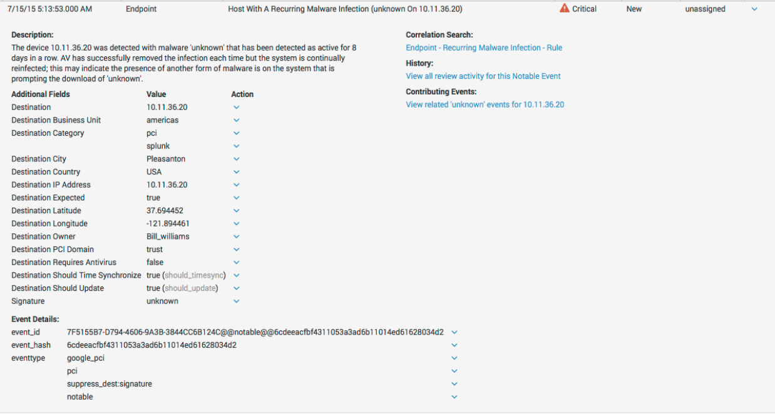
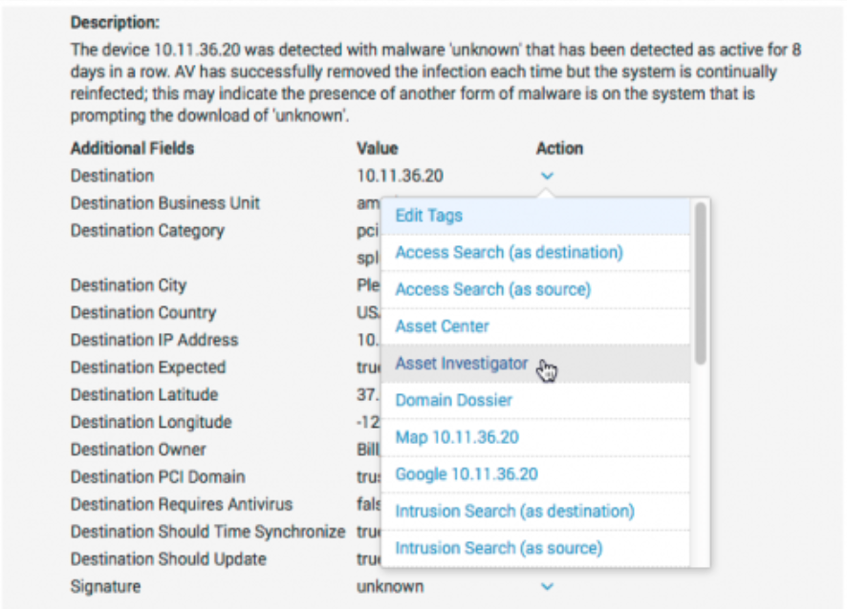

Slide 11
Notes:
Review a broader timespan of events

Slide 13
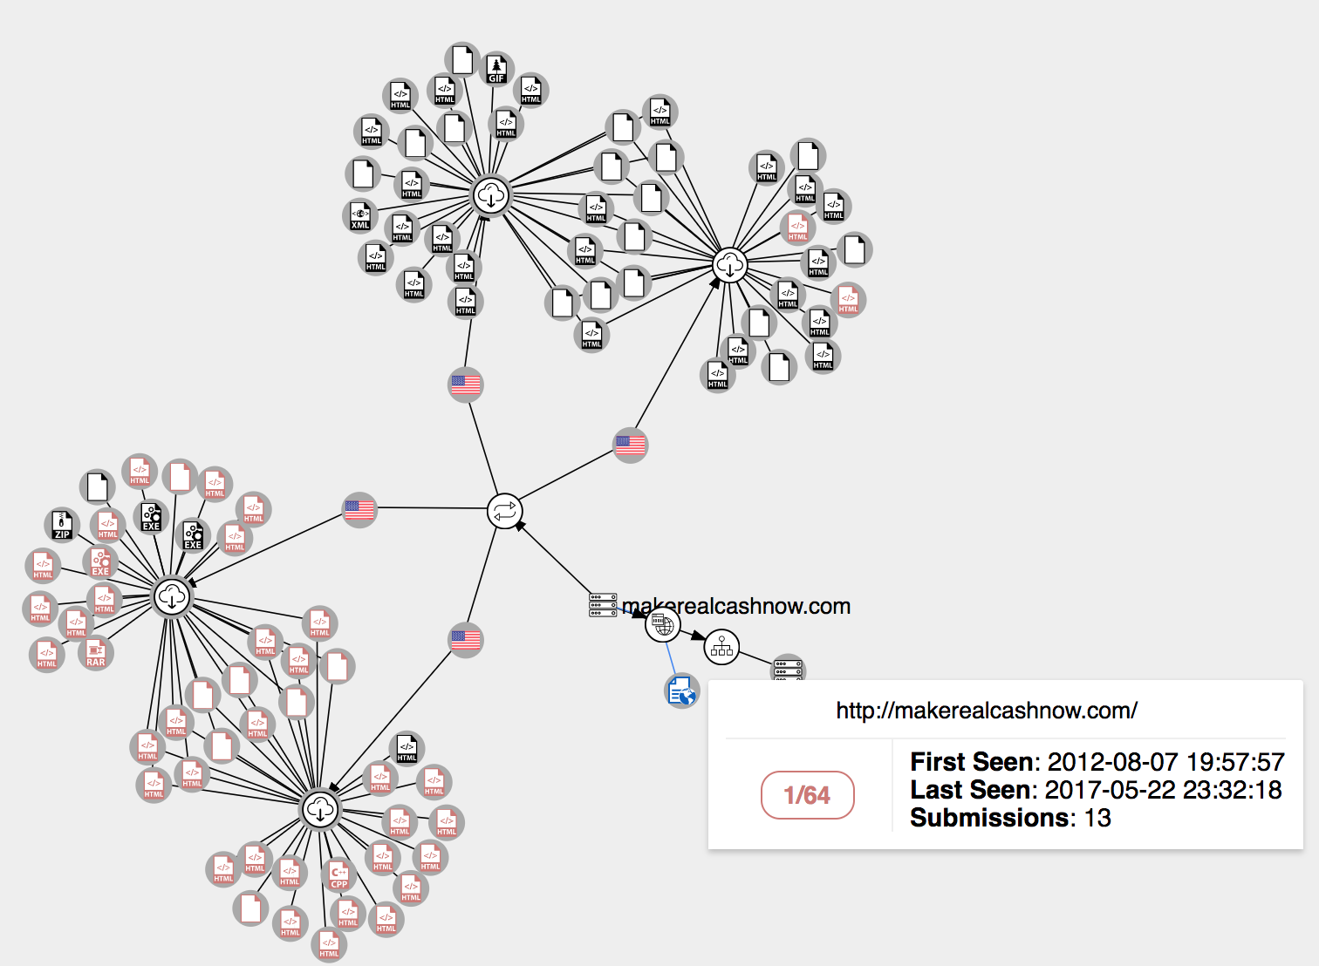
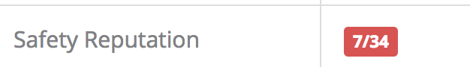

Slide 14
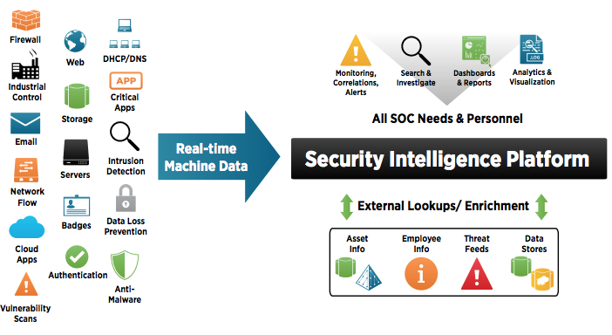
-Security intelligence -security and non-security sources in real time -enrich it with external data
Notes:
A critical piece of technology in a SOC is a security intelligence
This platform must be able to index all relevant machine data and log files from security and nonsecurity sources in real time. The platform must also be able to take the data and enrich it with external data, such as data from Active Directory, asset databases, third-party threat feeds and more. This external enrichment adds crucial context that can be used in real-time correlation rules to protect the most critical assets and users, as well as to paint a more complete picture in an incident investigation.
The resulting indexed data and external lookups can then be leveraged to meet key SOC needs, including real-time correlation rules and alerting, incident investigations, custom dashboards and reports, and advanced analytics including anomaly and outlier detection.

Slide 15
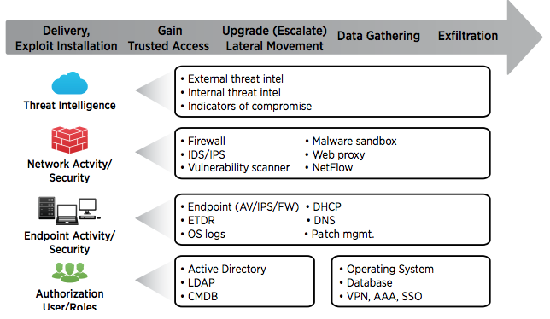
Notes:
There are a number of data sources that security intelligence platforms need to index and leverage
typically the data needed will come from four major categories: threat intelligence, network, endpoint and authentication.
helping to connect the dots and track a threat all the way from entry to exfiltration.

Slide 16
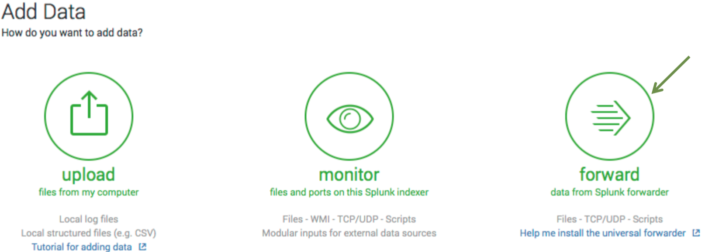
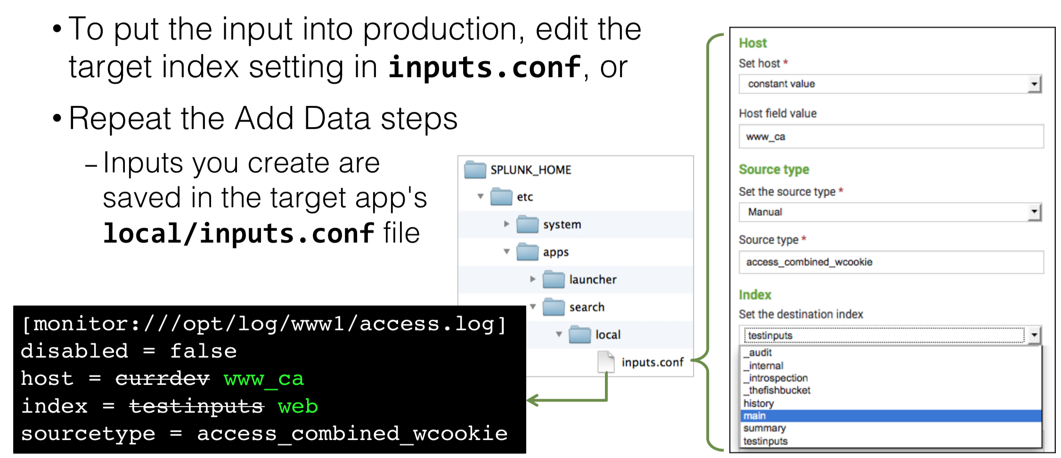
Input Types Files and directories Network data Script output Windows logs Add data inputs with -Apps and add-ons from Splunk Base – Splunk Web – CLI – Directly editing inputs.conf

Slide 17
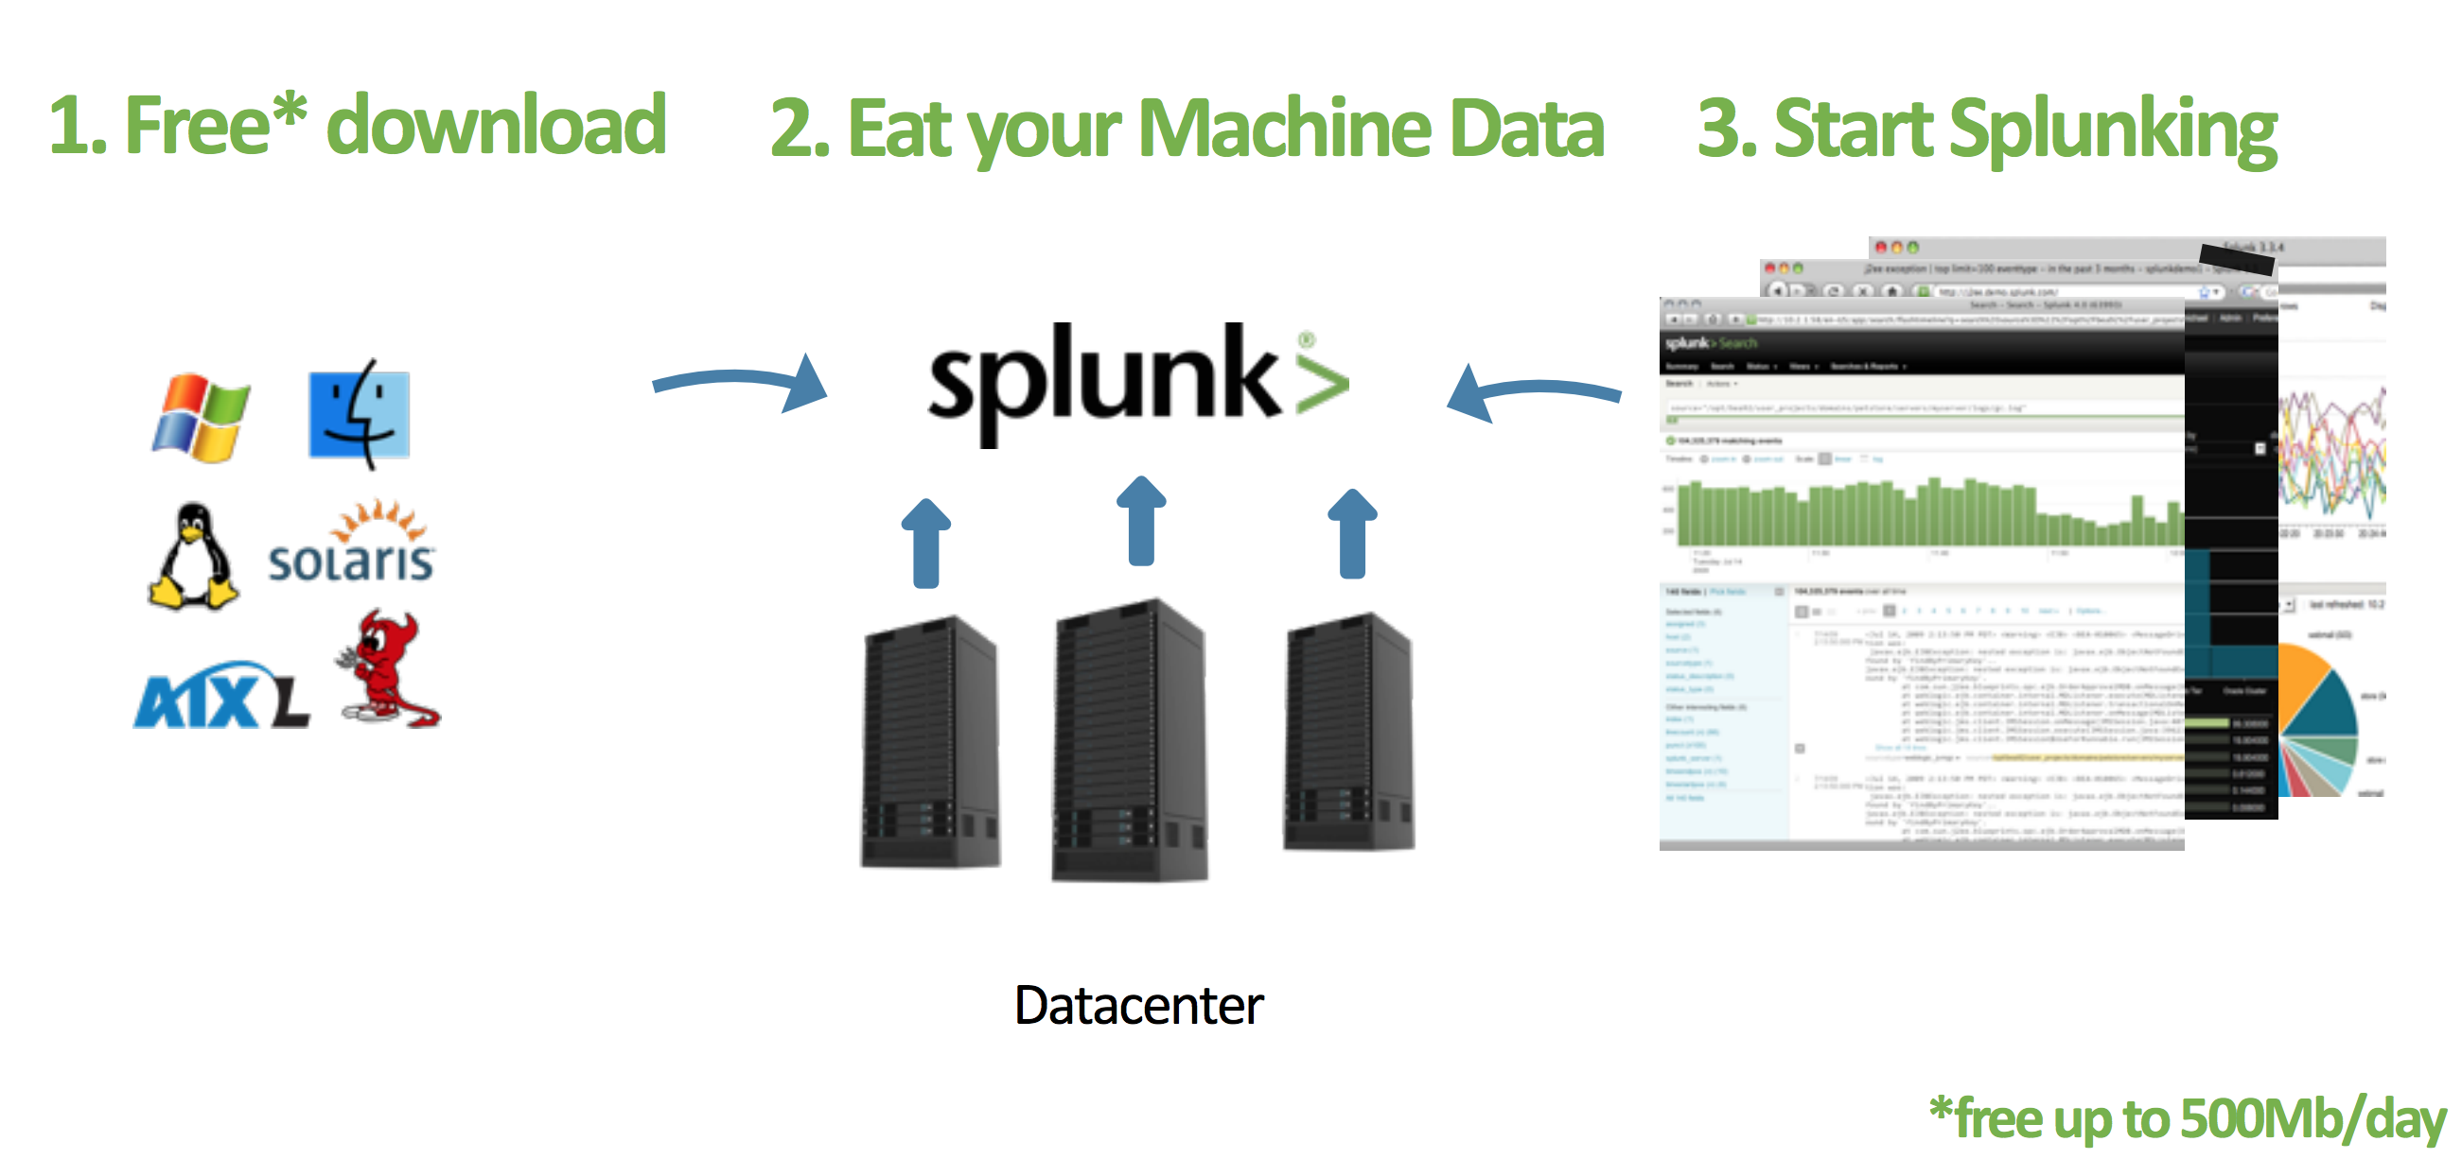
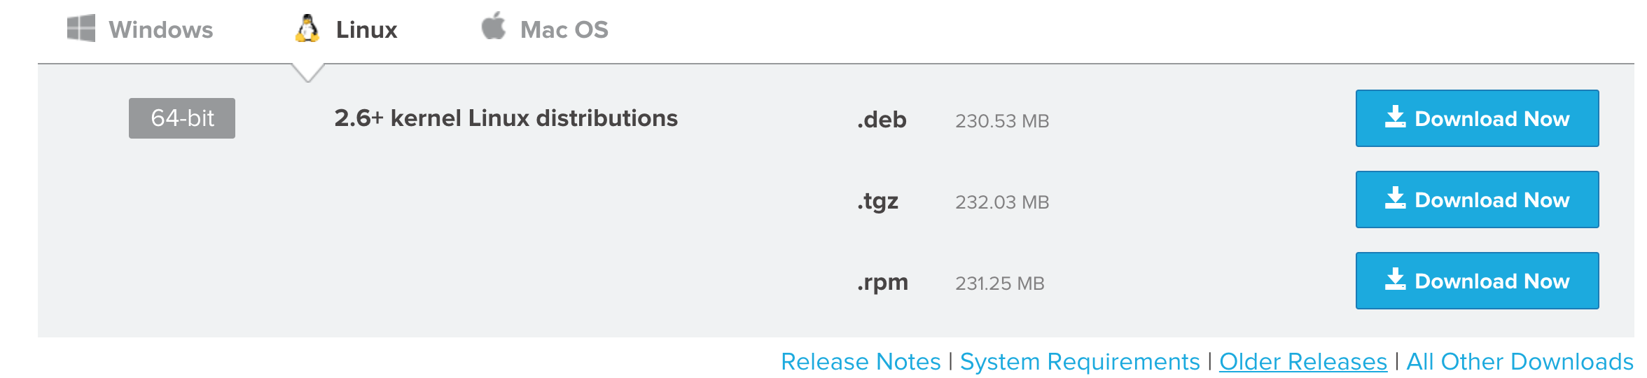
Free Download 60 days and you can index up to 500 megabytes of data per day.

Slide 18
PLEASE SHARE YOUR THOUGHTS

